Slide 1


Melody Meets Metrics
Reinventing Moosic's Playlist
Strategy with Data
Project by: Gustavo Rodriguez
Helene Rebelo
Lina Yordanova
January 29, 2024

Slide 2
Database
5114 songs
5235 songs
Information
name + artist = name_artist
id
danceability
energy
key
loudness
mode
speechiness
acousticness
instrumentalness
liveness
valence
tempo
type
duration_ms
time_signature
HTML
Unnamed: 0

Slide 3
K-Means clustering
Scaler: Min Max Scaler
Standard Scaler
Robust Scaler
Quantile Transformer
PowerTransformer
Shows how well the songs are grouped

Slide 4
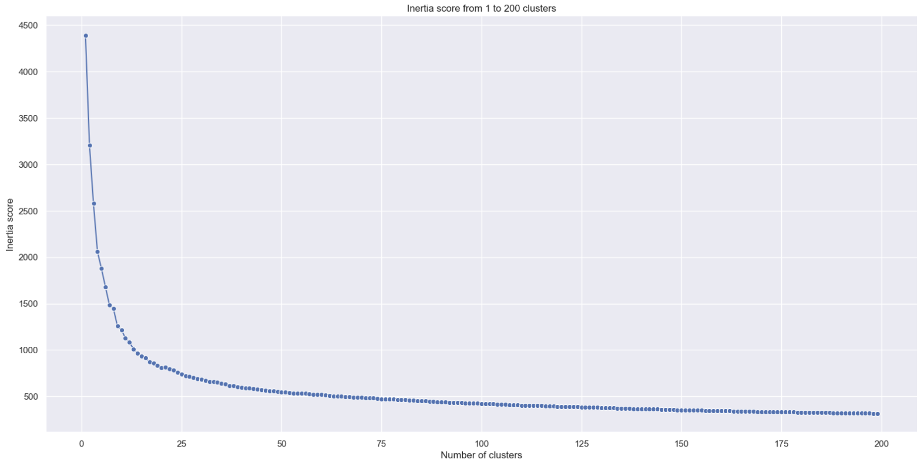
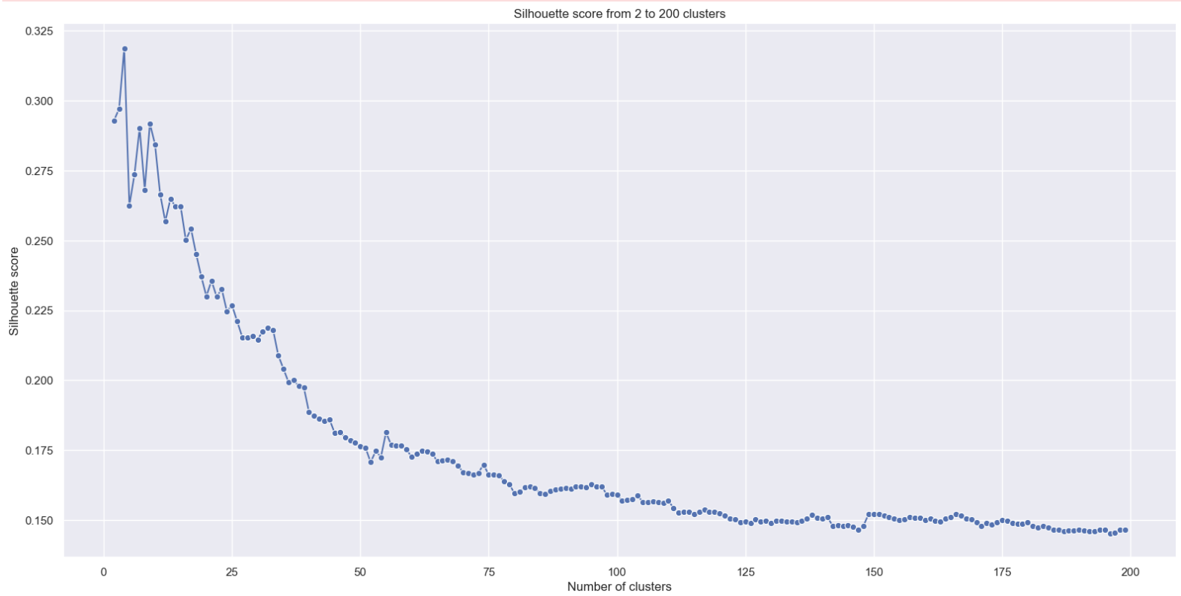
Number of clusters
Elbow methods
Silhouette methods

Slide 5
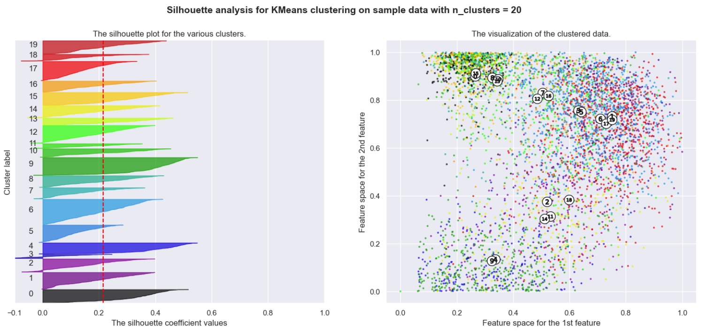
Silhouette methods
20 clusters = 0.21 average silhouettenscore

Slide 6
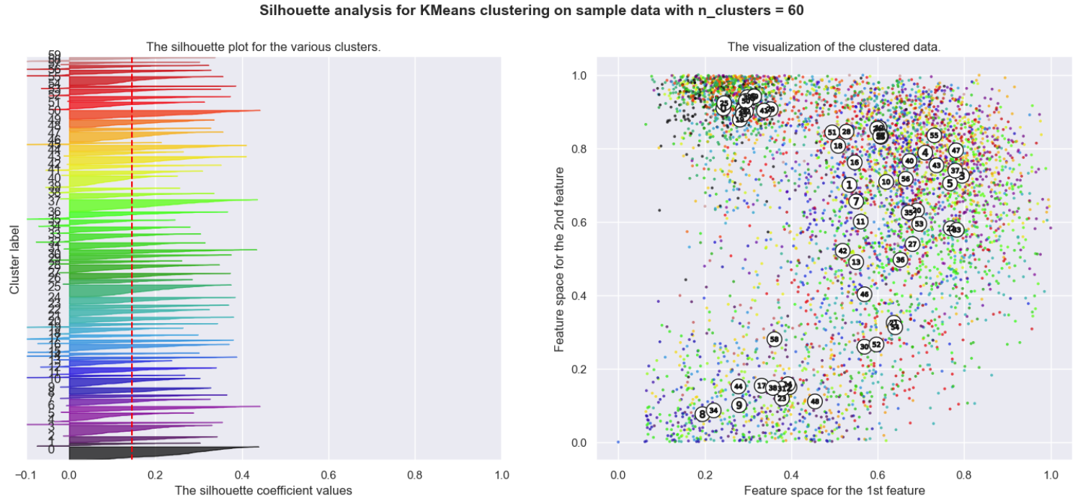
Silhouette methods
30 clusters = 0.19
50 clusters = 0.15
60 clusters = 0.14
80 clusters = 0.13

Slide 7
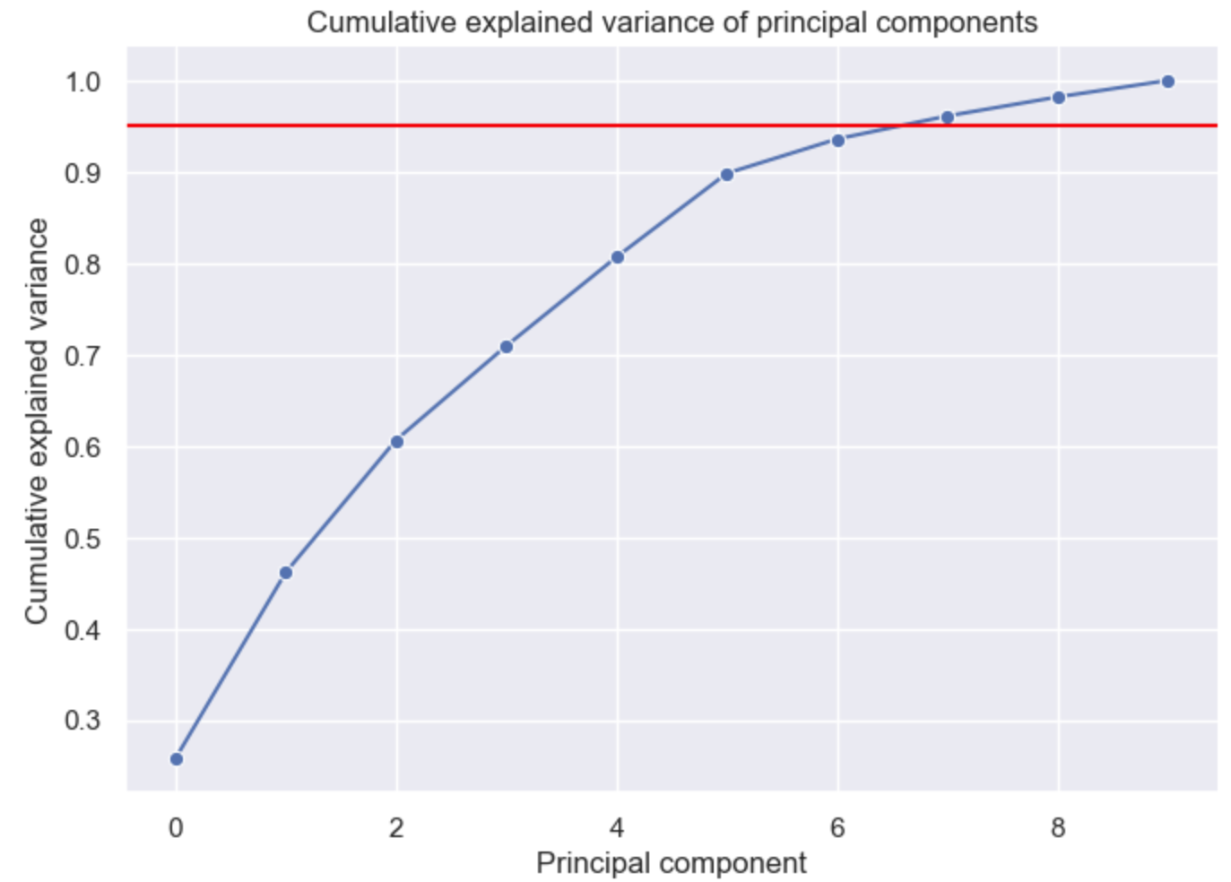
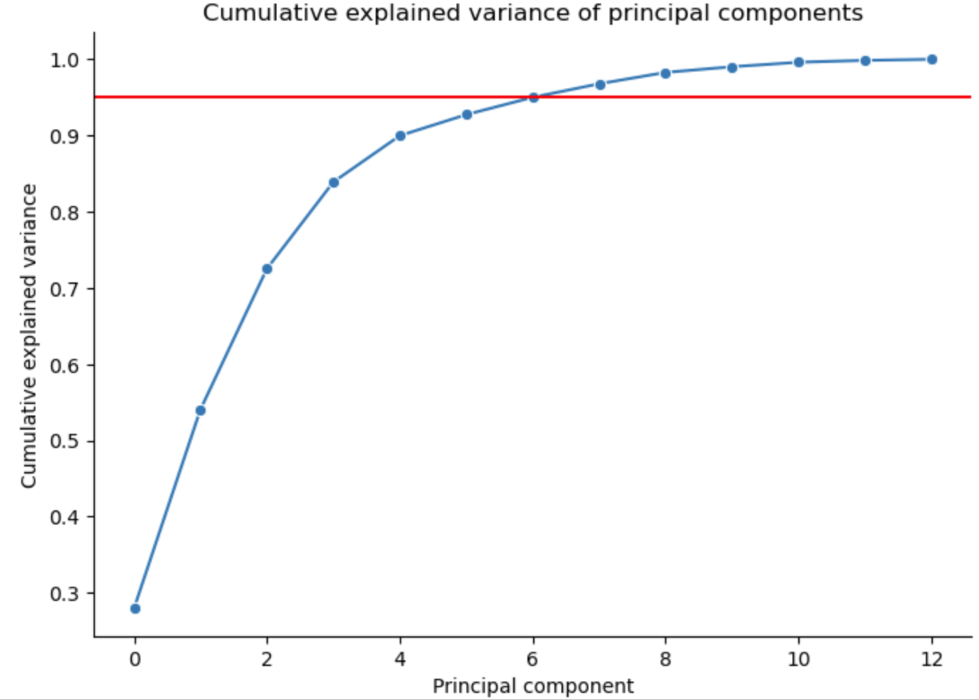
PCA - Principal component analysis
Choosing the number of PCA - 8
10

Slide 8
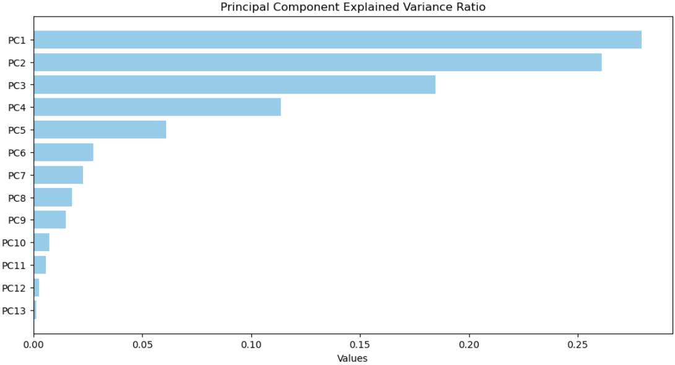

Slide 9
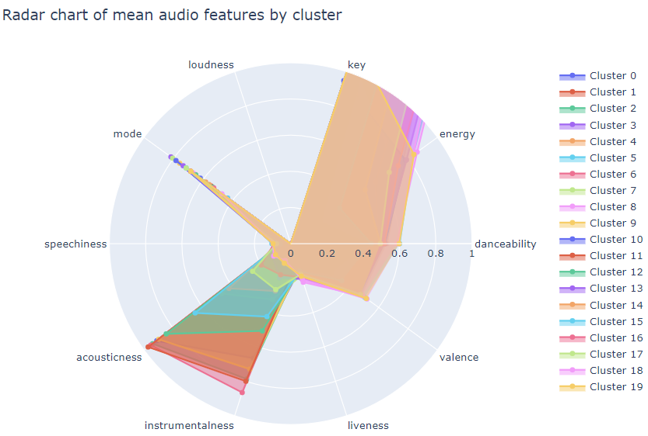
We dropped the features:
tempo, time_signature and duration_ms.

Slide 10
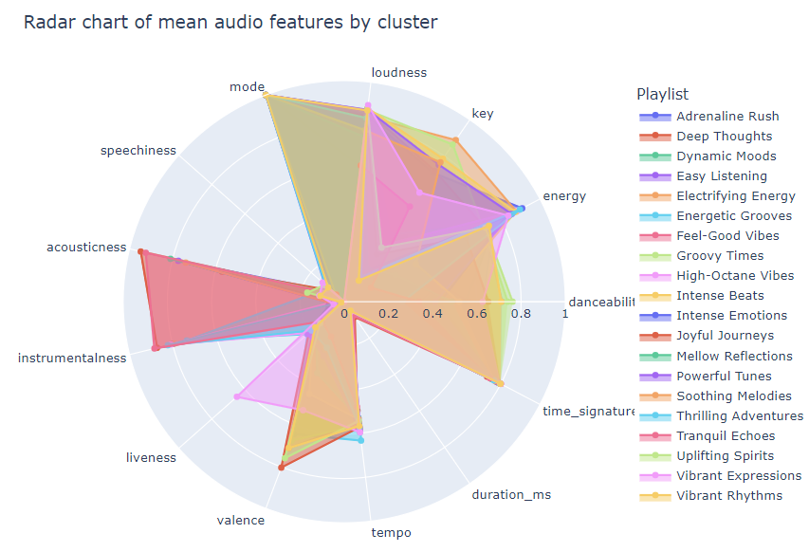
Results
All
Features

Slide 11
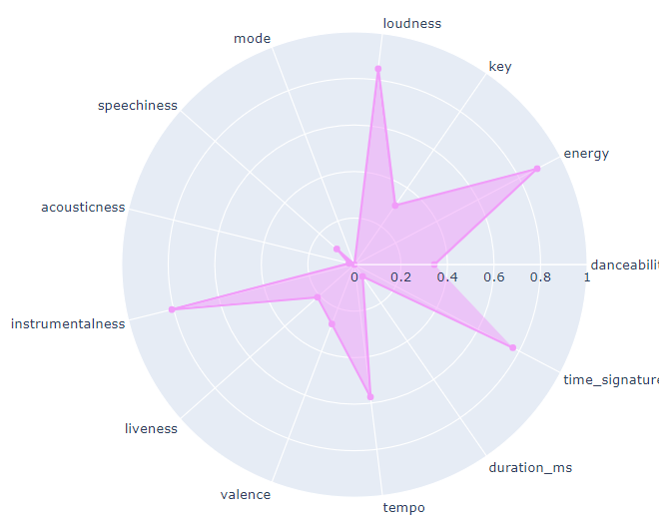
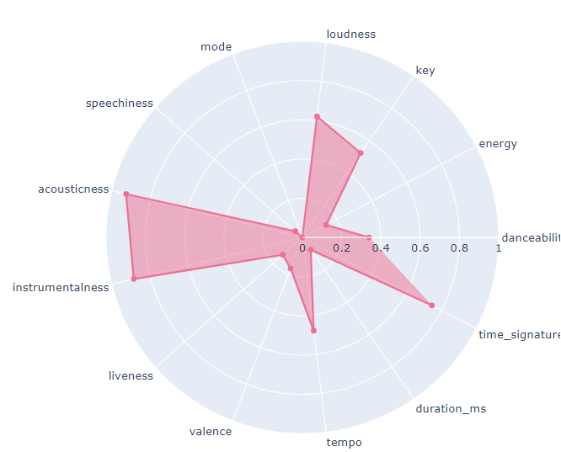
High-Octane Vibes:
Designed for the high-energy listener who thrives on intense, driving beats, such as during a challenging workout or an active night out.
Tranquil Echoes:
Aimed at individuals seeking peace and calm, such as during yoga, spa visits, or moments of stress relief.

Slide 12

Conclusions
The K-Means clustering: effective in segmenting data sets into distinct and meaningful groups
Ideal number of clusters: around 20 indicates good structure and separation between clusters
Using a machine to create playlists is time and cost effective, however, the results are far from replacing human capabilities
The clusters are easily transferable to Spotify or any other music platform

Slide 13


